Slide 1

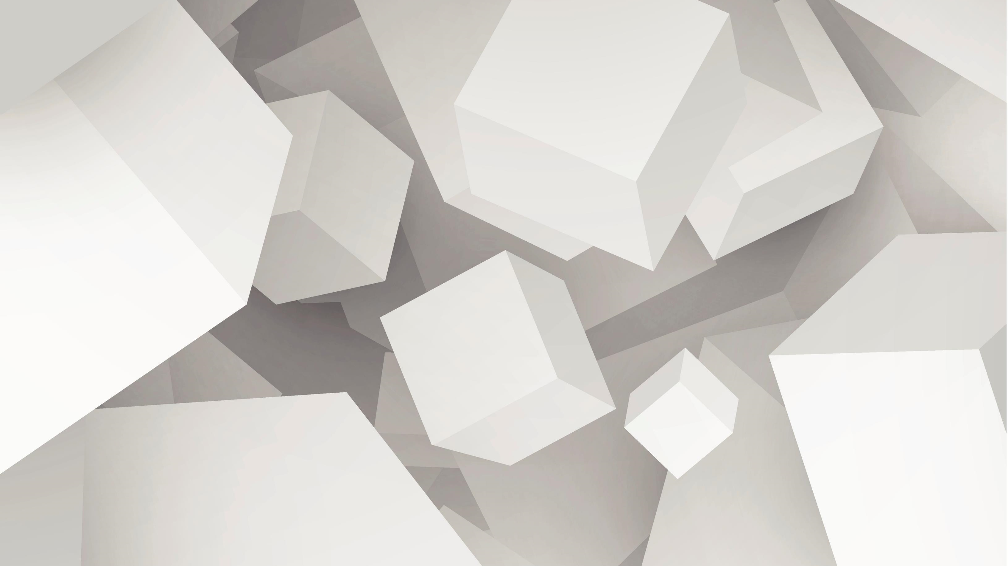
Deep Residual Learning for Image Recognition
Sushma Veluru- 700765390
Arvind Veda- 700774397

Slide 2
Abstract
Deep residual networks (ResNets) have revolutionized the field of computer vision by enabling the training of neural networks with hundreds or even thousands of layers. Traditional deep networks suffer from degradation — a phenomenon where adding more layers leads to higher training error. ResNets address this challenge by introducing residual learning, where the network learns the residuals (differences) between the input and output rather than the full transformation. This simple yet powerful idea allows easier optimization and improves accuracy in very deep networks. This presentation explores the motivation behind residual learning, the architecture of ResNets, experimental results on benchmarks like ImageNet and CIFAR-10, and the impact of ResNets on downstream tasks like object detection.

Slide 3
Motivation
Problem
Deeper networks are expected to perform better due to increased representational power.
In practice, training error increases with depth after a certain point — not due to overfitting but due to optimization difficulties.
Conventional deep networks (like VGG or AlexNet) suffer from vanishing/exploding gradients, making it hard to update early layers.
Solution
Propose learning residual mappings 𝐹(𝑥)=𝐻(𝑥)−𝑥instead of directly learning𝐻(𝑥).
Reformulate as 𝐻(𝑥)=𝐹(𝑥)+𝑥H(x)=F(x)+x, which makes the identity function easier to learn if it's optimal.
Introduce skip connections that perform identity mapping and add the input directly to the output of the residual function.

Slide 4
Residual Learning Concept
Equation
𝐻(𝑥)=𝐹(𝑥)+𝑥
Where:
𝐻(𝑥): Desired underlying function
F(x): Residual function to be learned
𝑥: Input to the layer
Key Observations
When the optimal function is the identity, residual networks can easily learn this by zeroing out 𝐹(𝑥).
Gradients can flow through identity connections without being diminished, thus solving the vanishing gradient problem.
Residual blocks act like gradient highways through the network.

Slide 5
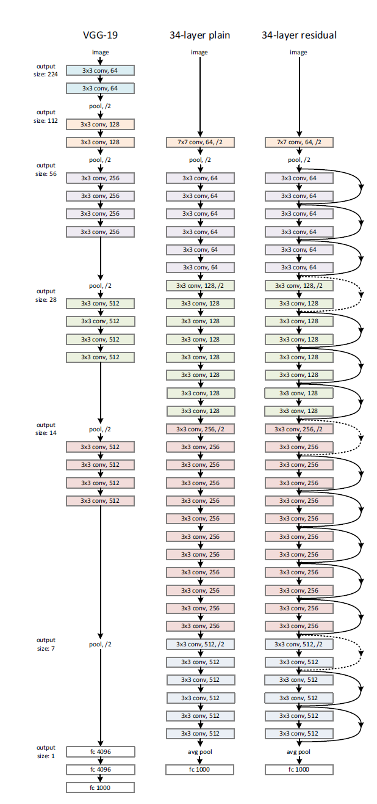
Building Block Diagram

Slide 6
ResNet Architectures
Plain vs. Residual Networks
18-layer and 34-layer plain networks vs. their residual counterparts showed significant degradation in the plain version.
With residual connections, deeper models performed significantly better.
Building Blocks
Two main types:
Basic Block (used in shallower networks like ResNet-18/34):
Two 3x3 convolutional layers with identity shortcut.
Bottleneck Block (used in deeper networks like ResNet-50/101/152):
A stack of: 1x1 → 3x3 → 1x1 convolutions
Reduces and then expands dimensions for computational efficiency.
Shortcut Types
Identity Shortcut: Used when input and output dimensions match.
Projection Shortcut (via 1x1 conv): Used when dimensions differ or when downsampling is needed.

Slide 7
Experimental Setup
Datasets
ImageNet (ILSVRC 2012): 1.2M training images, 1000 classes
CIFAR-10: 60K images (32x32), 10 classes
Training Details
Optimizer: Stochastic Gradient Descent (SGD) with momentum (0.9)
Learning Rate Strategy:
Initial LR: 0.1
Step decay: divide by 10 at defined epochs
Normalization: Batch Normalization after each convolution
Regularization:
No dropout used
Weight decay: 1e-4
Testing Enhancements:
10-crop testing
Multi-scale inference for robust evaluation

Slide 8
ImageNet Results
ResNet-152 achieved 3.57% top-5 error — a new benchmark at the time.
Outperformed:
GoogLeNet (Inception): ~6.7% top-5 error
VGG-19: ~7.3% top-5 error
Deeper = Better (up to a point):
ResNet-50, 101, and 152 showed consistent improvements.
ILSVRC 2015 Champion:
Ensemble of ResNets won the classification task.

Slide 9
CIFAR-10 Results
Trained ResNets with up to 1202 layers.
Traditional networks failed beyond 20–30 layers.
ResNets maintained or improved accuracy with depth.
Insight: Residual functions tend to have smaller magnitudes, leading to better generalization and optimization.

Slide 10
Object Detection Results
Trained ResNets with up to 1202 layers.
Traditional networks failed beyond 20–30 layers.
ResNets maintained or improved accuracy with depth.
Insight: Residual functions tend to have smaller magnitudes, leading to better generalization and optimization.

Slide 11
Application to Object Detection
Integrated into Faster R-CNN for object detection tasks.
Benchmarks:
PASCAL VOC
MS COCO
Performance:
Significant mAP improvement over VGG-16 backbone.
Demonstrated ResNet’s versatility beyond classification.

Slide 12
Conclusion
Residual learning overcomes degradation and optimization problems in deep networks.
Enables training of extremely deep networks (over 1000 layers).
Framework is general, scalable, and modular — adaptable to many vision tasks.
Set a new state-of-the-art in classification, detection, and segmentation.
Paved the way for follow-up architectures like ResNeXt, DenseNet, and Transformers using residual principles.

